Slide 1
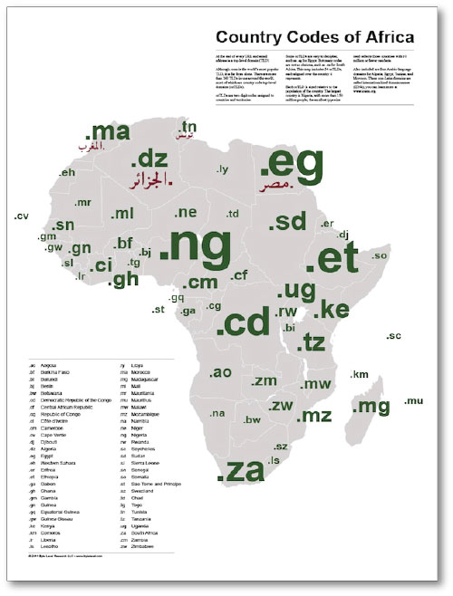

Slide 2
Importance of ccTLDs in the Society – Nigeria and You.
Akinbo A. A. Cornerstone
CETL, My Nigeria Online (MyNOL)
Wednesday, September 14th, 2011

Slide 4
Focal Presentation
ccTLDs in the Society
NiRA Update

Slide 5
ccTLDs in the Society

Slide 6
What is a ccTLD?
Loosely defined, a country code top level
domain is a domain name allocated to a
specific country in terms of the domain
name system (DNS) tree & is open to
having sub-domains below it.
(e.g:.ke,.mg,.za,.mz, .ca and yours truly .ng)

Slide 8
ccTLD functions
Promote domain name space
Local policy development
Participation in international fora
ICANN, IGF, etc
Online country branding
National pride

Slide 9
ccTLD functions
Internet & e-business uptake
Economic development thru competition
Registry
Registrar
Reseller

Slide 10
ccTLD functions
Broader ICT development
Capacity building
Set standards & procedures
Licensing regime
Industry self-regulation
Domain name dispute resolution (ADR)

Slide 11
ccTLD composition
Government
Private sector (ISPs & other business)
Academic institutions
Civil society

Slide 12
Characteristics
ccTLDs are monopolies
Few friends, many adversaries
Develop to be self-sustaining
National resources – no ltd ownership
Competition from gTLDs (.com, .biz)
Perception of gTLDs having wider reach
Need for effective ccTLD marketing

Slide 14
Past: Nigerian challenges
Limited number of operational platforms
Lack of technical infrastructure & skills
Limited buy-in from governments
Insufficient knowledge sharing
Lack of DNS education & awareness

Slide 15
Benefits
A lot of the importance for having an appropriate ccTLD comes down to search optimization.
Some of the benefits of having a ccTLD are that people are slightly more likely to trust them and they will rank better in certain countries.
Anyone in the world can get a.com address and having the extra few letters in front of it may seem more trustworthy and official.

Slide 16
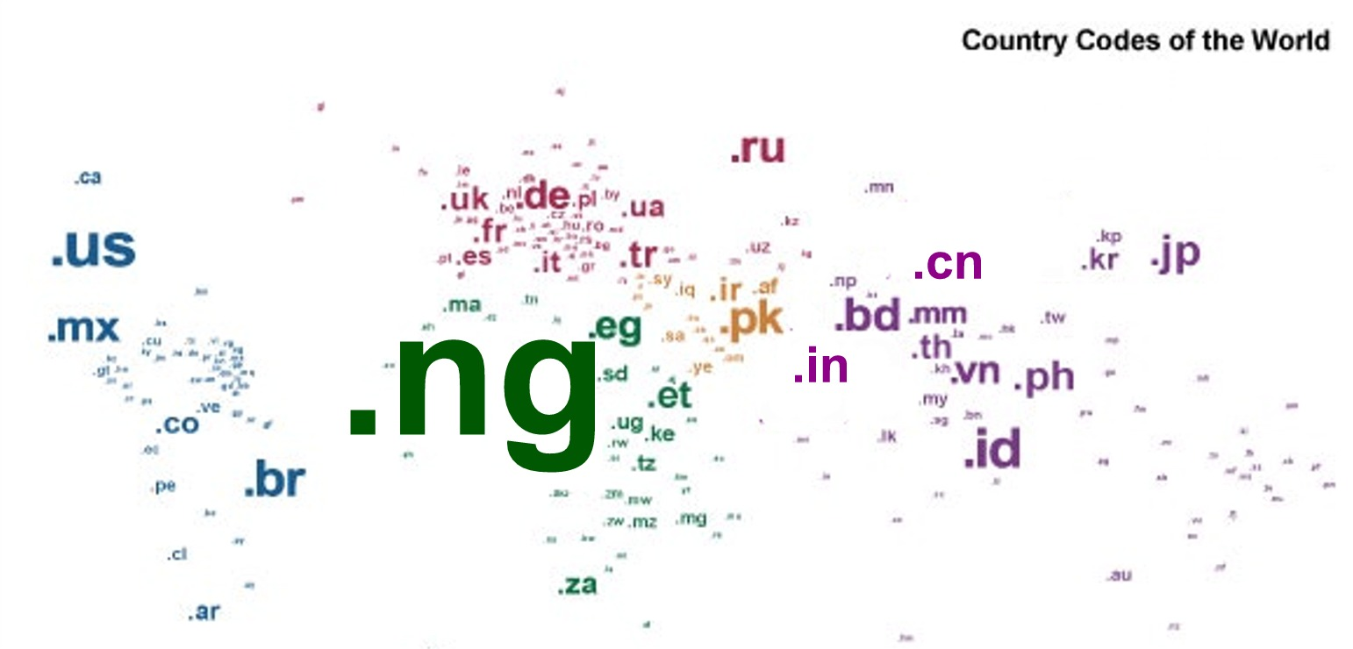

Slide 17
Conclusion
Internet development & uptake
Enable participation in international policy & technical development fora
Part of national branding
Facilitate ICT skills development

Slide 19
NiRA Update

Slide 20
Executives of the Board
Know your NiRA Officials.
Visit the official site on
www.nira.org.ng.

Slide 21
Current Focus
Constitutional Amendments
Fundraising Campaign
Communications & awareness
Participation in strategic events
More active communication with NiRA
Branding & reviving mailing lists
Regular website update & translation

Slide 22
Current focus
Member mobilization
Capacity building
IPv6, registry management tools, etc
establishment & best practices
Event in early 2011 & AGM, others thereafter
MOU with strategic organizations

Slide 25
☺
Thank you.
http://www.nira.com.ng

